Slide 1
MICRO CREDIT DEFAULTER

Slide 2

PROBLEM STATEMENT AND UNDERSTANDING
Telecom industry are collaborating with an MFI(micro finance Institution) to provide micro-credit on mobile balances to be paid back in 5 days. The Consumer is believed to be defaulter if he deviates from the path of paying back the loaned amount within the time duration of 5 days. For the loan amount of 5 (in Indonesian Rupiah), payback amount should be 6 (in Indonesian Rupiah), while, for the loan amount of 10 (in Indonesian Rupiah), the payback amount should be 12 (in Indonesian Rupiah).
So the company want the customers who pay back the loan within the deadline. For that., we have some data and we want to perform models for predictions, who will pay back the loan.

Slide 3
EDA steps and visualizations

Slide 4
EDA steps
In this project there is no missing values, but there is zero value for some features.
We want to treat them as missing values, replacing zero value with the mean.
Data contains date, which have string data type , we want to convert it
Using pandas date time, we can convert it into date time, by separating month and date
One of the feature is the region, it consist of only one data , contain only one region. We can drop that column and the date column which is converted date time using pandas.
By checking the skew ness and outliers we can detect in our dataset using visualization techniques histogram and boxplot.
We can remove the skew ness using power transform method and outliers using Z score.
While removing outliers there is huge amount of data loss, up to 25% of data were loss. So I prefer to not to remove outliers.

Slide 5
Scaled features using Standard scaler .
When we look at the output variable, we can observe the imbalance of the class. Here I use smote technique to balance the class.
After all this EDA steps, perform models and compare the CV score and Accuracy score of the model for finalizing the model.

Slide 6
Visualizations

Slide 7
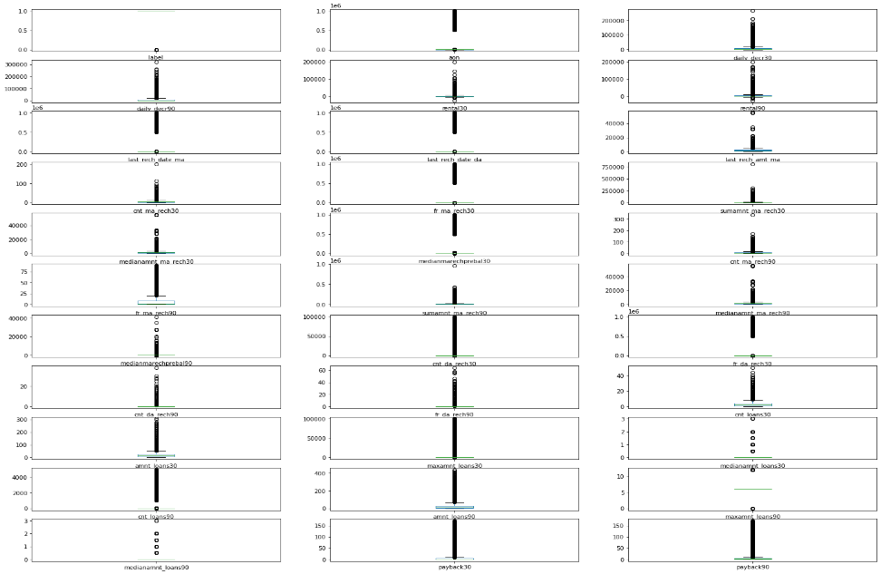
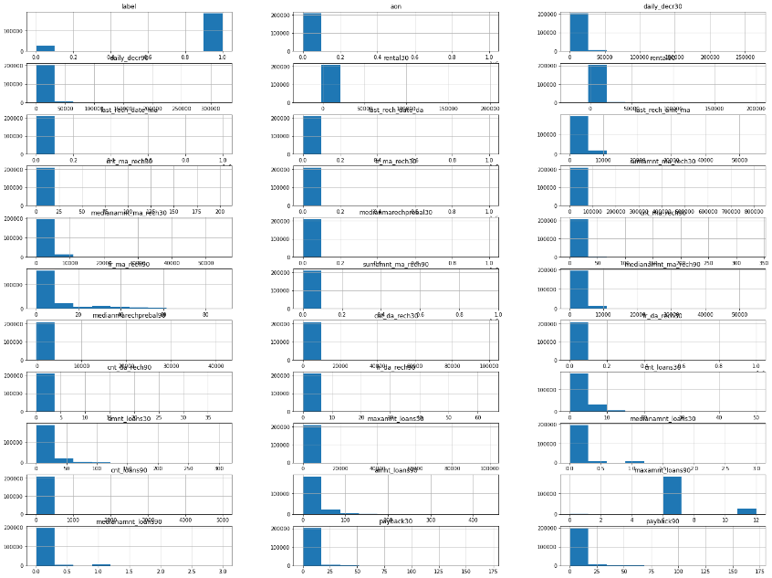
Outliers and Skew ness
Outliers checking using boxplot
Skew ness checking using histogram.

Slide 8
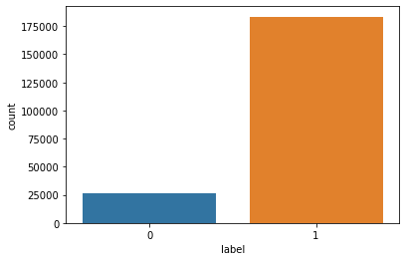
Output Variable

Slide 9
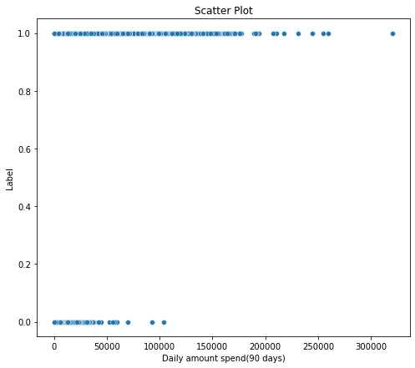

Comparing features with target variable
Daily amount spend(90 days)
Daily amount spend(30 days)

Slide 10
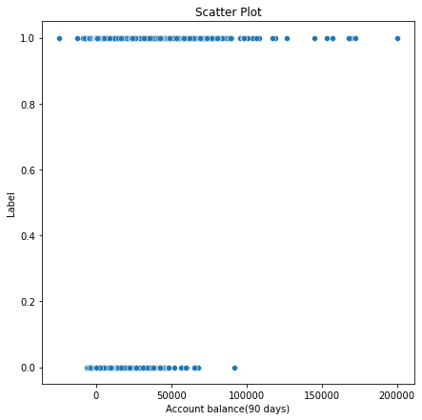
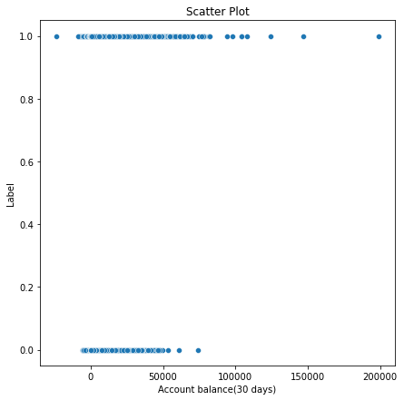
Account balance(90 days)
Account balance(30 days)

Slide 11
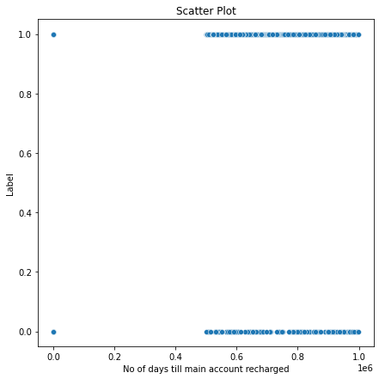
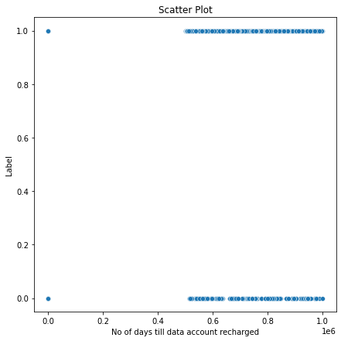
No of days till main account recharged
No of days till data account recharged

Slide 12
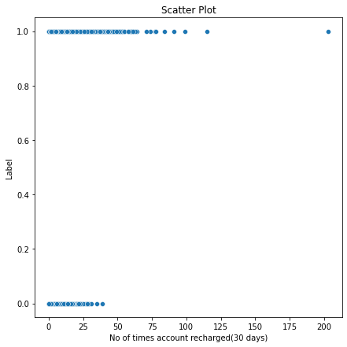
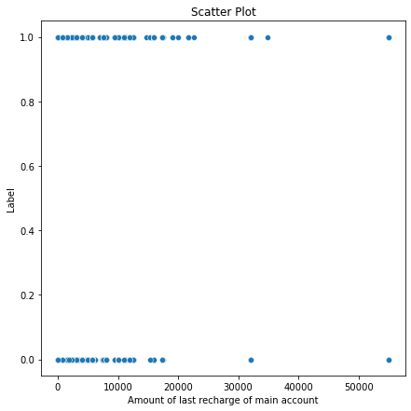
No of times account recharged(30 days)
Amount of last recharge of main account

Slide 13
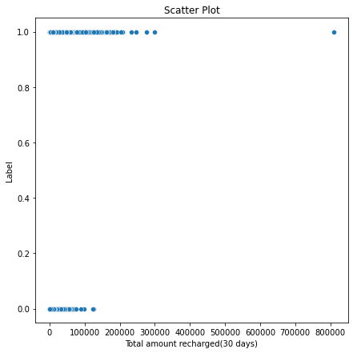
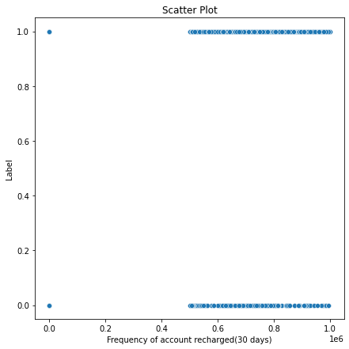
Total amount recharged (30 days)
Frequency of account recharged (30 days)

Slide 14
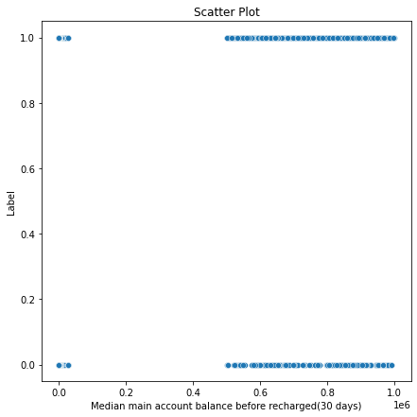
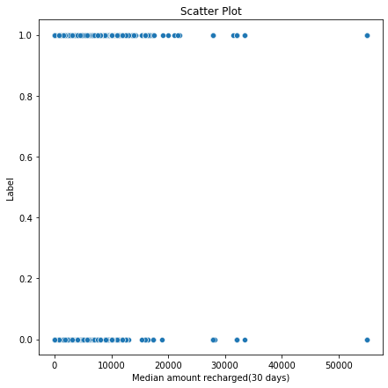
Median main account balance before recharge
Median amount recharged(30 days)

Slide 15
Account balance(30 days)
Account balance (90 days)

Slide 16
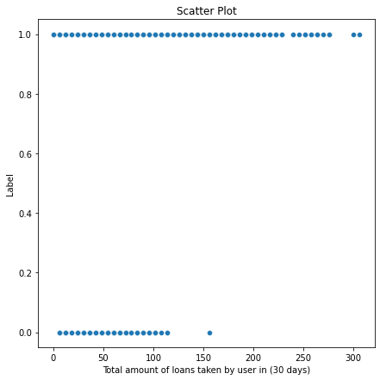
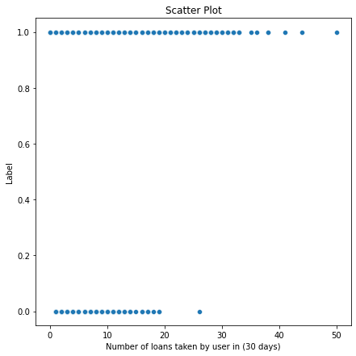
Amount of loans taken by user(30 days)
No of loans taken by user(30 days)

Slide 17
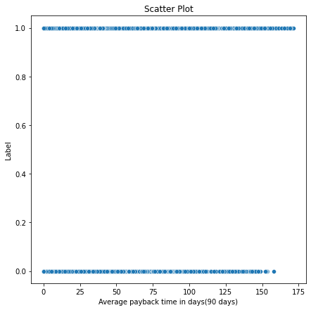
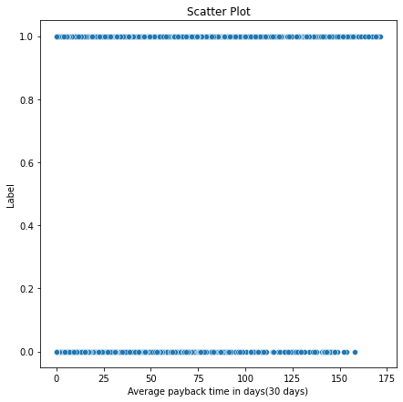
Payback time in 30 days
Payback time in 90 days

Slide 18
Correlation

Slide 19
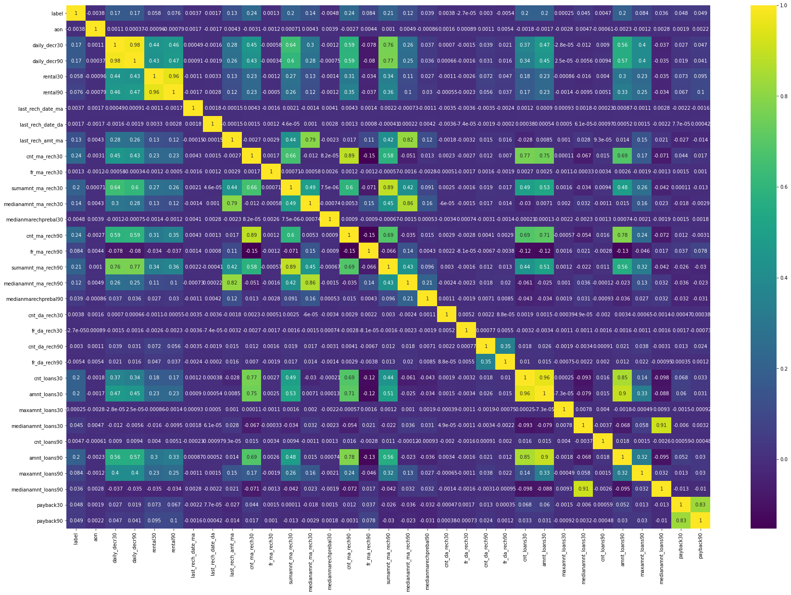

Slide 20
Steps and Assumptions

Slide 21
As the data is about the mobile recharge, data are given in currency(Indonesian rupiah).
After all EDA steps, we want to perform multiple models.
Data are given in 30 days and 90 days data. So these data are highly correlated.
For example, the feature balance of the account of the user in 30 days and 90 days are correlated.
We can assume that the customer who have the enough balance in account have the tendency to pay back the loan.

Slide 22
Model dashboard
For a good prediction we want to select which is the best model for the given project.
So we want to perform multiple models for selecting best model.
Here in this project, I perform four different models, four of them have different accuracy score.
Among them we want to select the final model and we want to mention the reason why it is final model.
We want to check the best random states , which have no over fitting or under fitting.
We want to compare the precision and recall of the model to finalize the model.

Slide 23
Which model gives equal CV(Cross validation) score and accuracy score is selected as final model.
When a model’s accuracy and cv score is not equal, don’t select that model as our final model.
In this project I selected random forest classifier as my final model because it have equal cv and accuracy score compare to other models.
After selecting final model tune the model with best parameters, and run the model with best parameters.
Here I tuned the random forest with best parameters and got accuracy of 81%.

Slide 24
Conclusion
So we can conclude that, the customer who have balance in account, what is pay back time of the user after taking loan? Whether they pay back in deadline?
If the user have the features above mentioned, that is have sufficient account balance, pay back the loan within particular time will pay back the loan.
Company can consider this customer as non-defaulter.
So company can select those customers for giving loan. And company will get some small investment and get profits.

